Slide 1


2021
Netcoreconf
Tu ciclo de Release es lento? Feature flags al rescate!!
Luis Mañez
Chief Architect
@luismanez
27/02/2021

Slide 2


Luis mañez
Chief Architect
ClearPeople LTD (UK)
https://github.com/luismanez
@luismanez
www.linkedin.com/in/luismanez
Office Development MVP. About 20 years of experience working with Microsoft Technologies. MS Certified specialist in Developing Azure and SharePoint MCPD. Passionate about technology, blogger, technical writer and MS community active member.

Slide 4

Tu ciclo de Release es lento? Feature flags al rescate!!

Slide 5

Why is my release so
Slow?

Slide 6
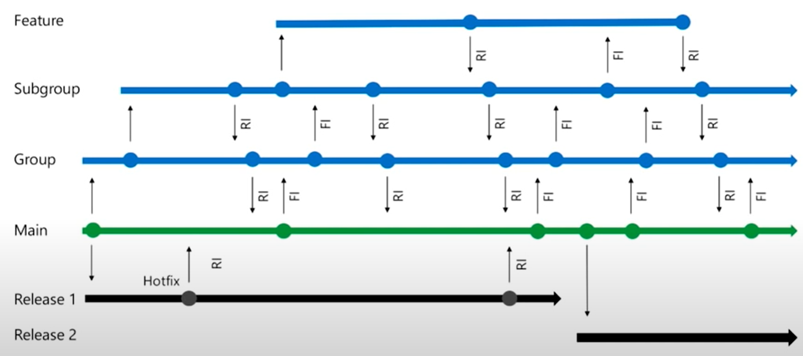
Feature branching / GitFlow
Git patterns and anti-patterns for successful developers : Build 2018 (Git patterns and anti-patterns for successful developers : Build 2018 - YouTube)

Slide 7
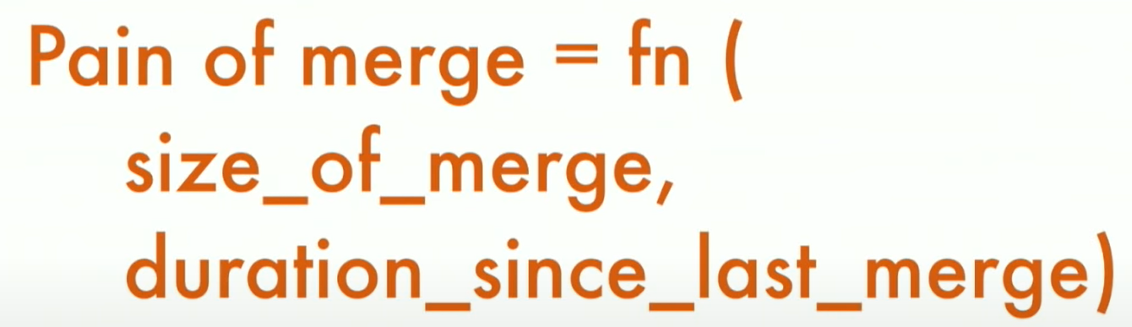
Feature Branches and Toggles in a Post-GitHub World – Sam Newman (https://www.youtube.com/watch?v=lqRQYEHAtpk)

Slide 8
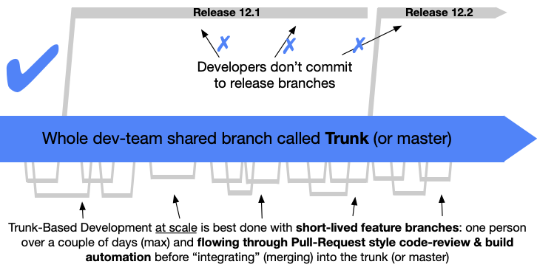
Trunk-Based Development

Slide 9
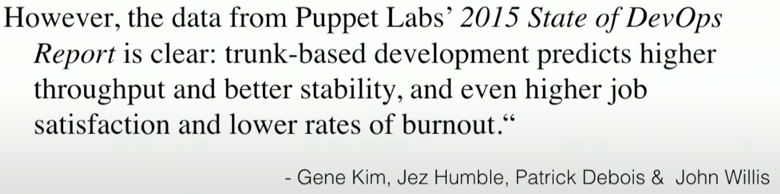
Feature Branches and Toggles in a Post-GitHub World – Sam Newman (https://www.youtube.com/watch?v=lqRQYEHAtpk)

Slide 10



Slide 11


There is NO Feature Flag
It´s just someone else’s IF

Slide 12





Feature Flags Frameworks
Esquio

Slide 13
ASP.NET Core Feature Flags
https://github.com/microsoft/FeatureManagement-Dotnet/

Slide 14

Who wants a Demo?

Slide 15
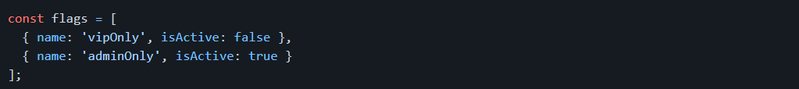
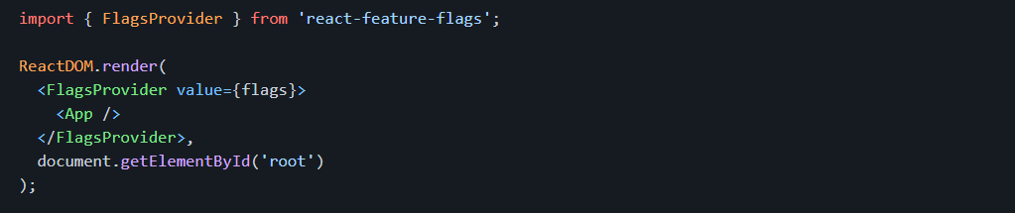
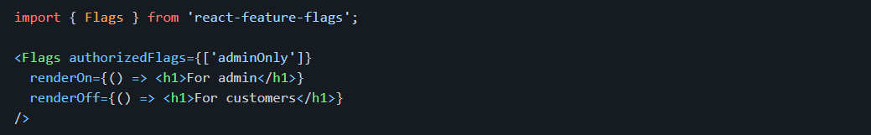
Feature flags in Client side
1
Load the available flags from server side
2
Wrap your root component with FlagsProvider and pass your flags to it with the value props.
3
Then you can wrapped the desired component as children to a Flag component
https://github.com/romaindso/react-feature-flags

Slide 16

https://github.com/luismanez/netcoreconf-2021

Slide 18
More information:
info@netcoreconf.com
@Netcoreconf
Visit on:
netcoreconf.com
Thanks

